Slide 1

CLK generator 1 2
Digital outputs(8) : 1 2 3 4 5 6 7 8 Analog Outputs(4) : 1 2 3 4
To microcontroller
LogiLAB
Digital switches 1 2 3 4 5 6 7 8
Half Adder
Full Adder
Half SUB
Full SUB
RS FF
JK FF
LEDS 1 2 3 4 5 6 7 8
D FF
T FF
Logic gates : AND x 4 , OR x 4 , NOT X 4 , XOR x 4 RK,
Parallel Adder substractor
DECODER
ENCODER
Half SUBMUX
DEMUX

Slide 2

Half Adder
A
S
C
B

Slide 3
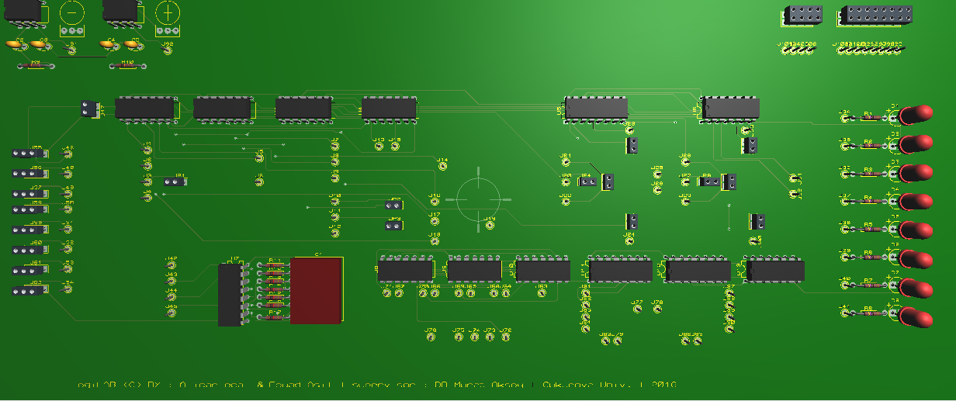
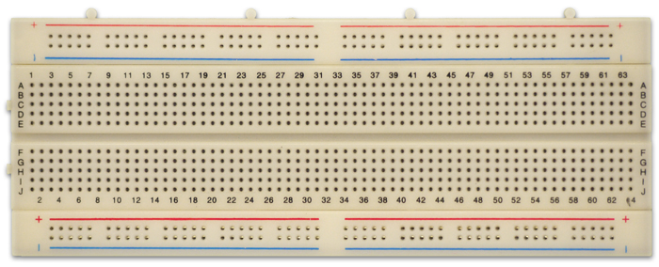
CLK generator 1 2
To microcontroller
Digital outputs(8) : 1 2 3 4 5 6 7 8 Analog Outputs(4) : 1 2 3 4
LogiLAB
LEDS 1 2 3 4 5 6 7 8
Digital switches 1 2 3 4 5 6 7 8
Half Adder / Substractor
Full Adder / Substractor
Flip Flop’s
7 seg Decoder
Parallel Adder substracter
MUX
DEMUX

